Slide 1
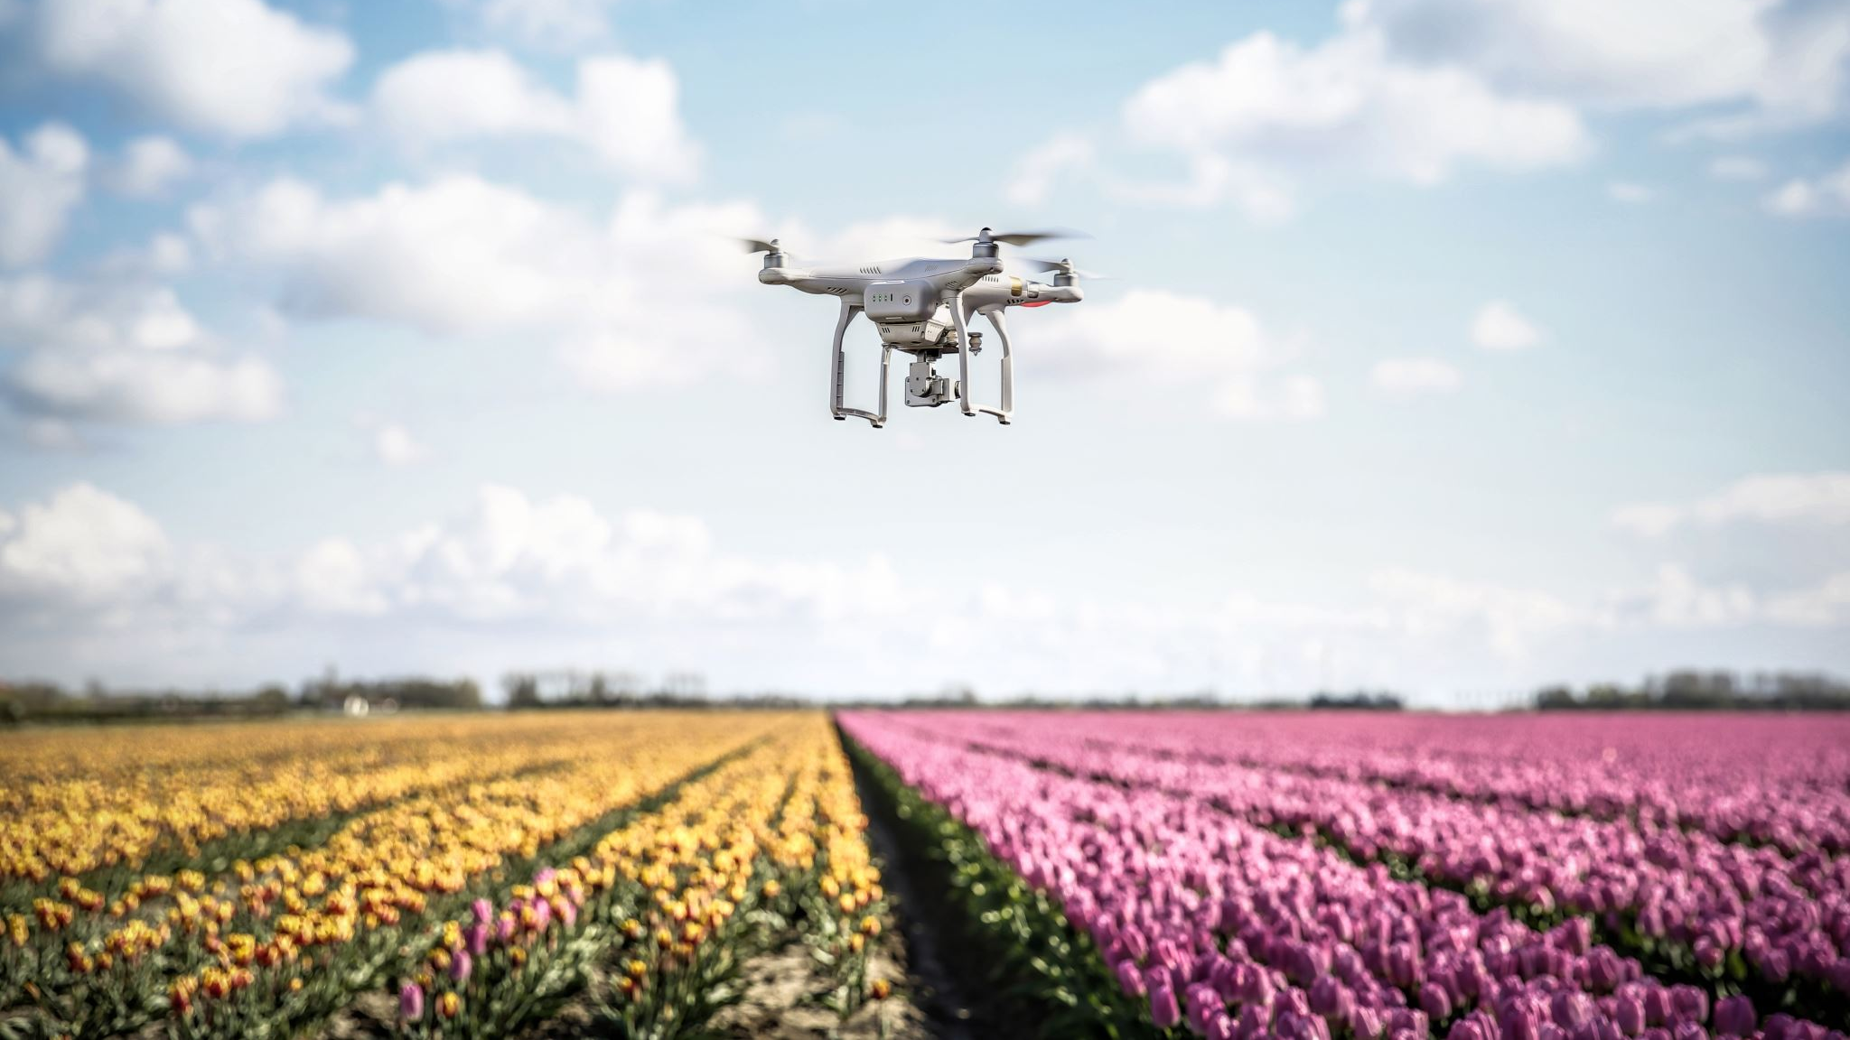
Aerial Agriculture Robotics
NICOLÁS CUEDO, BRAIAN SOULLIER
BRIAN VELAZQUEZ, RAÚL ZAPATA
Notes:
1-8, 43 Brian
9-24 UNQ
25-31 Raul
32-42 UNQ

Slide 2







Agenda
Introduction
Literature Review
Problem Statement
Current Investigations
Results
Challenges
Future Research

Slide 3
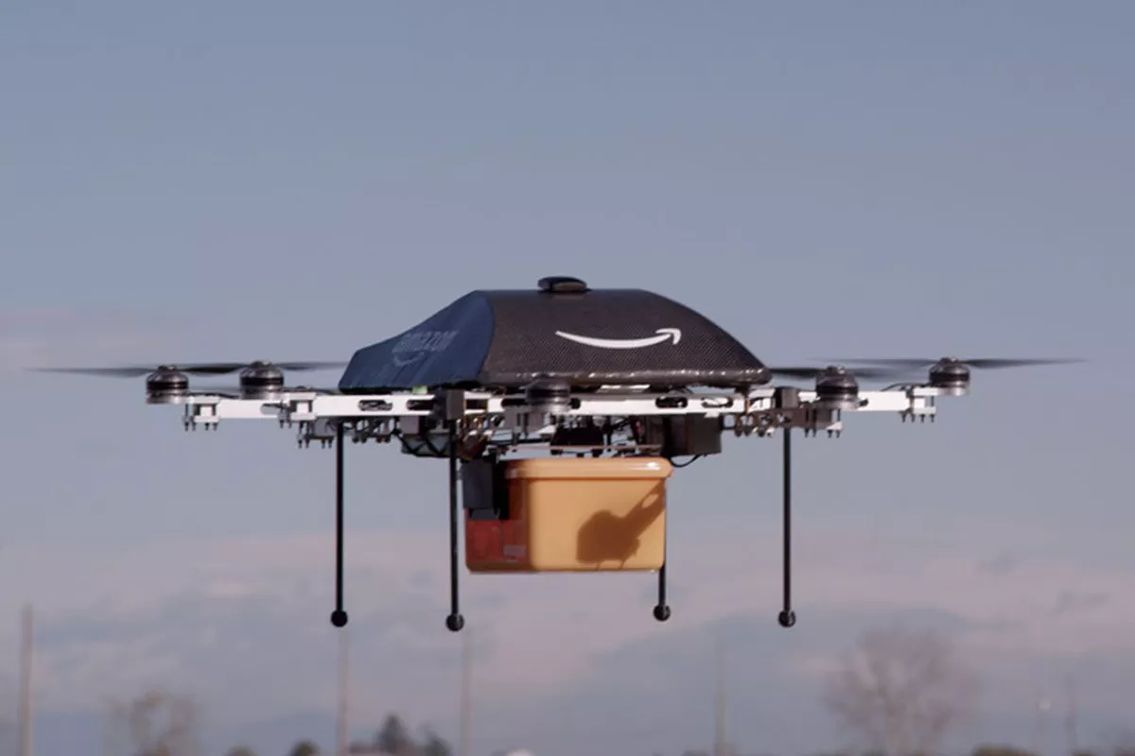
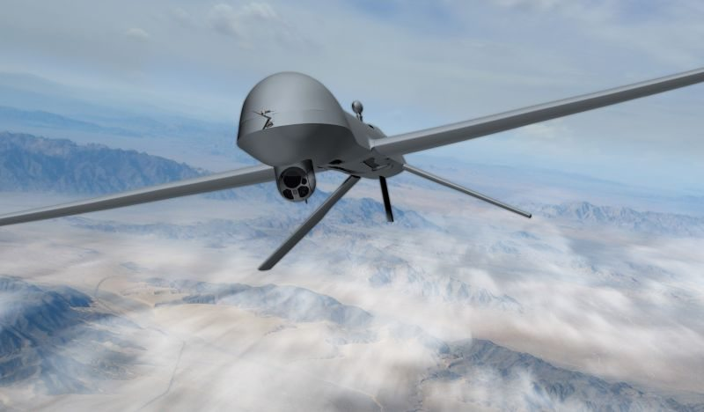
Introduction
Drones are used in the Public and Private Sector.
Public Sector
Military
Surveillance
Delivery (Medical)
Private Sector
Delivery (Commercial)
Photography\Videography
Agriculture

Slide 4



Crop Protection
Normalized Difference Vegetation Index (NDVI) Monitoring
Plants Pathology Monitoring
Crop Water Stress Index (CWSI) Monitoring
Trichogramma
Used to identify poor soil fertility.
Science of Plant Disease by Pathogens
Irrigation Requirements per Type of Crop.
Precision Spraying of Fertilizers and Pesticides

Slide 5
Precision Agriculture in the Drone Age
Agricultural Precision is about Just-In-Time (JIT) for more rentability, sustainability, and productivity in Agricultural Fields.
Protect agriculture fields from pests.
Responsible use of the product.
Maximize harvest.

Slide 6
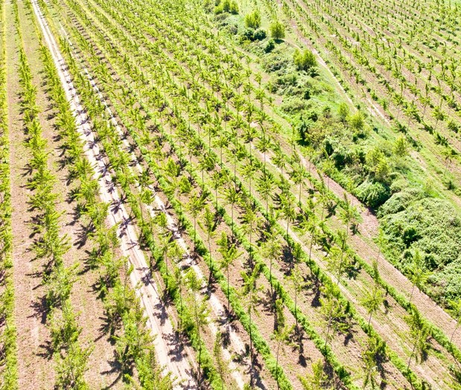
Problem Statement
Detection of Crop Lines and Weeds Patches from videos acquired from a Quadcopter using Image Analysis.
Geo-location of information using GPS for Precise/Accurate Identification for Locations of Interest.
Visualization of Information with Open Geographic Information System (GIS) Tools.

Slide 7
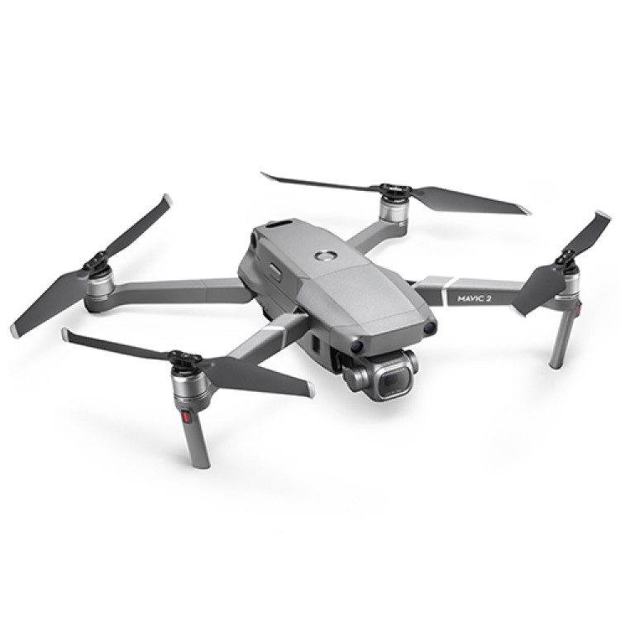
Mavic DJI Pro 2
Video resolution: 4K: 3840×2160 24/25/30p 2.7K: 2688x1512 24/25/30/48/50/60p FHD: 1920×1080 24/25/30/48/50/60/120p
Max Speed: 72 Km/h (S-mode)
Range: 6000 m

Slide 8
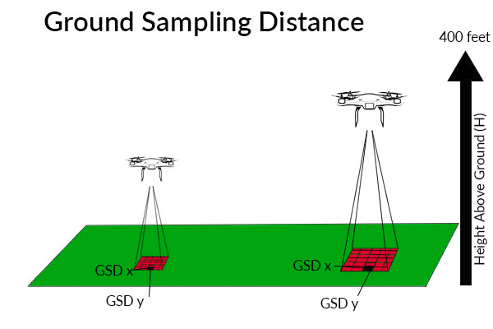
Flying Parameters
Velocity = 1 m/s
Altitude = 4m
Flight Mode = Tap to Fly

Slide 9
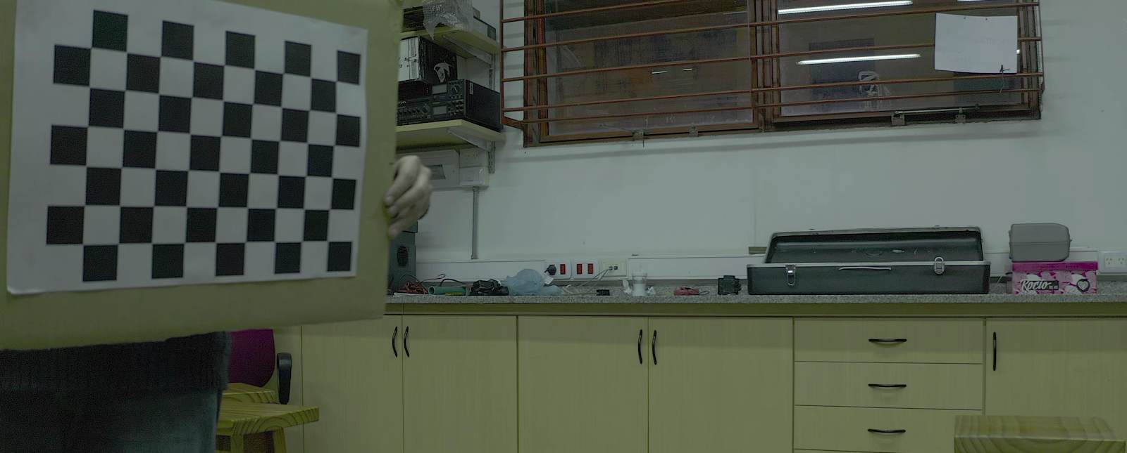
Calibration of DJI Camera

Slide 10
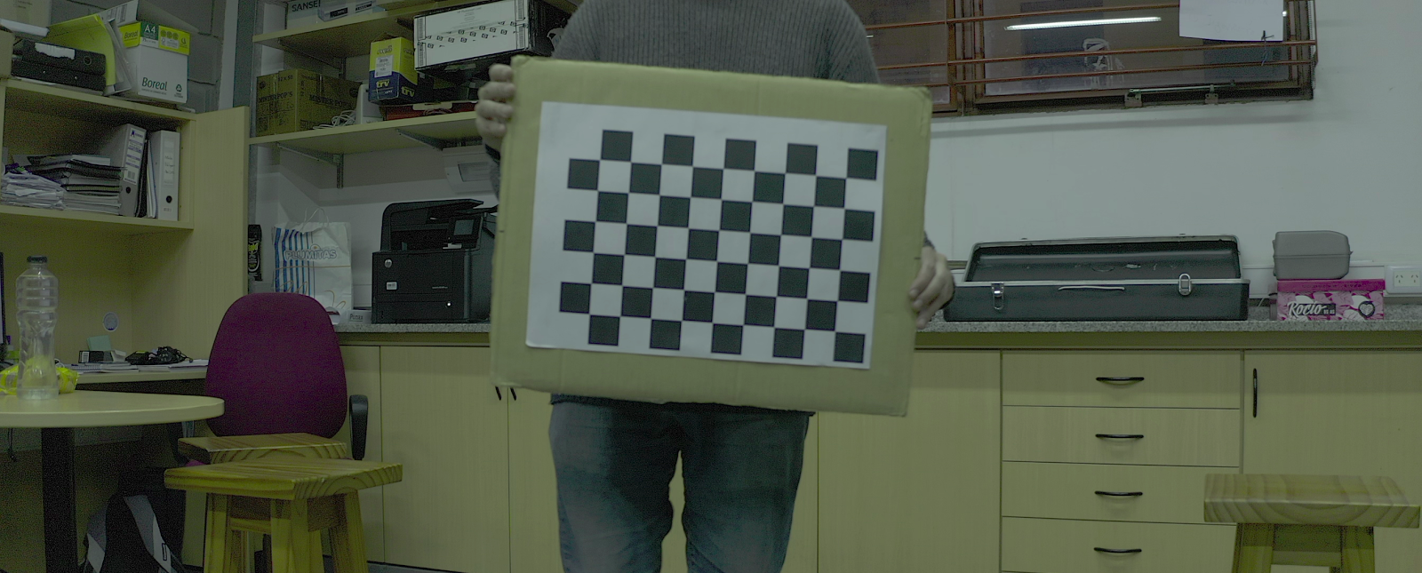
Calibration Pt. 2

Slide 11
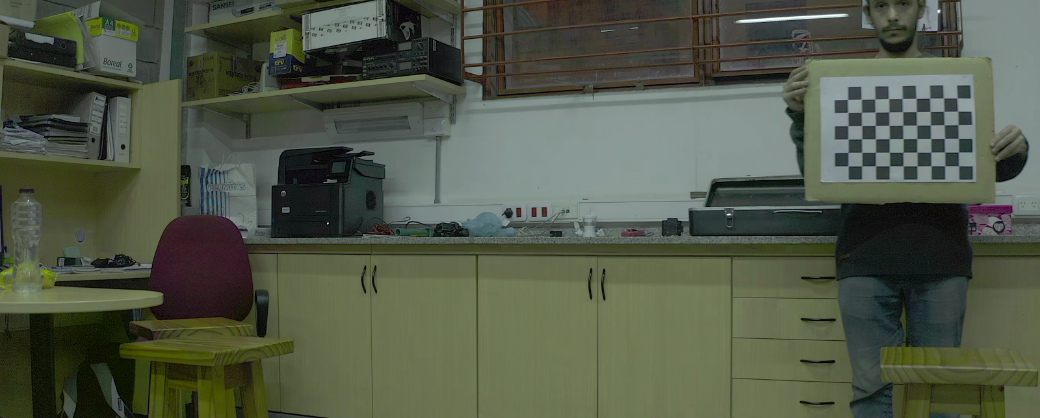
Calibration Pt. 3

Slide 12
Distortion Correction

Slide 13
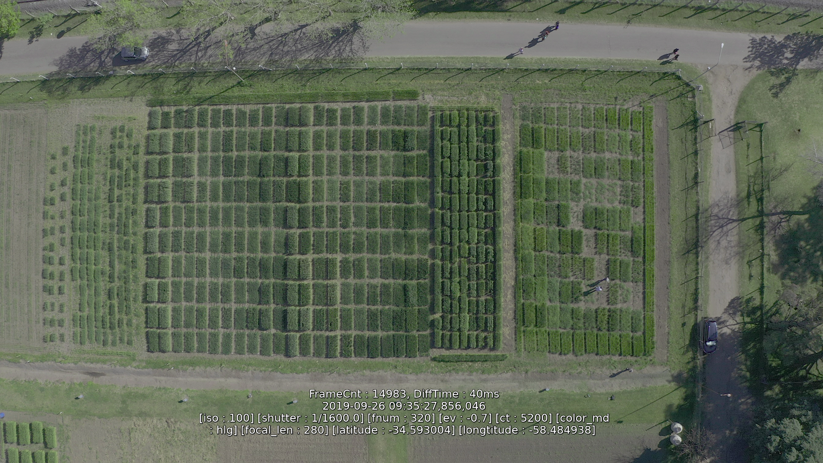

Slide 14
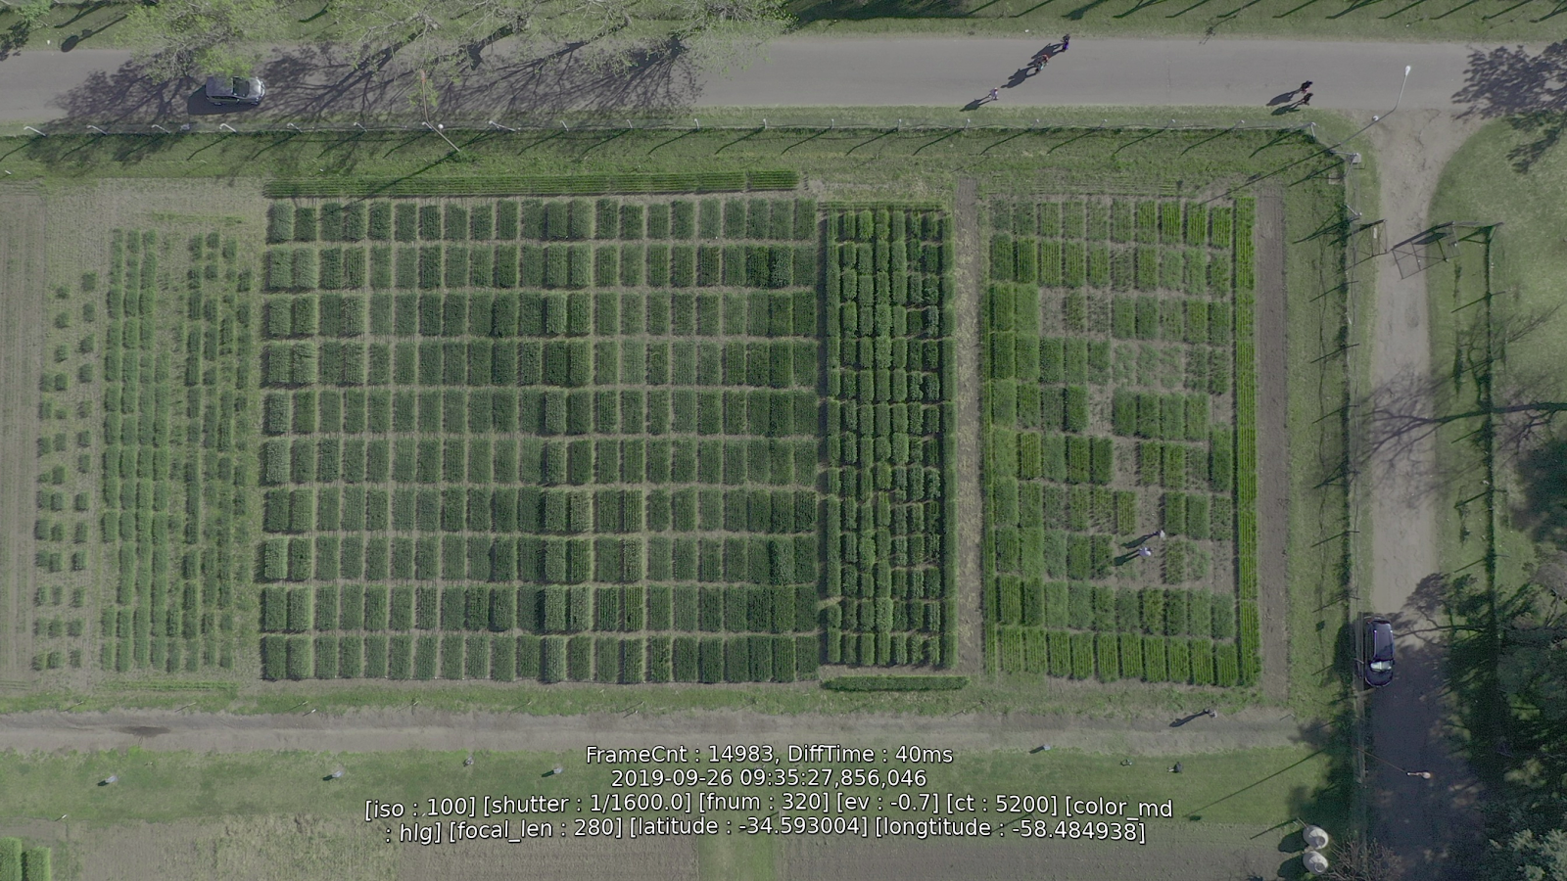

Slide 15
Geolocation Reference
Coordinates
Longitude (-34.592979)
Latitude (-58.484649)

Slide 16
Geodetic Geolocation Referencing
Distance from Origin to Selected Point.
Distance [x] = 63.28 m
Distance [y] = 18.82 m
Total Distance = 66.02 m

Slide 17
Ellipsoidal Geolocation Referencing
Distance from Origin to Selected Point.
Distance [x] = 61.45 m
Distance [y] = 18.28 m
Total Distance = 64.11 m

Slide 18
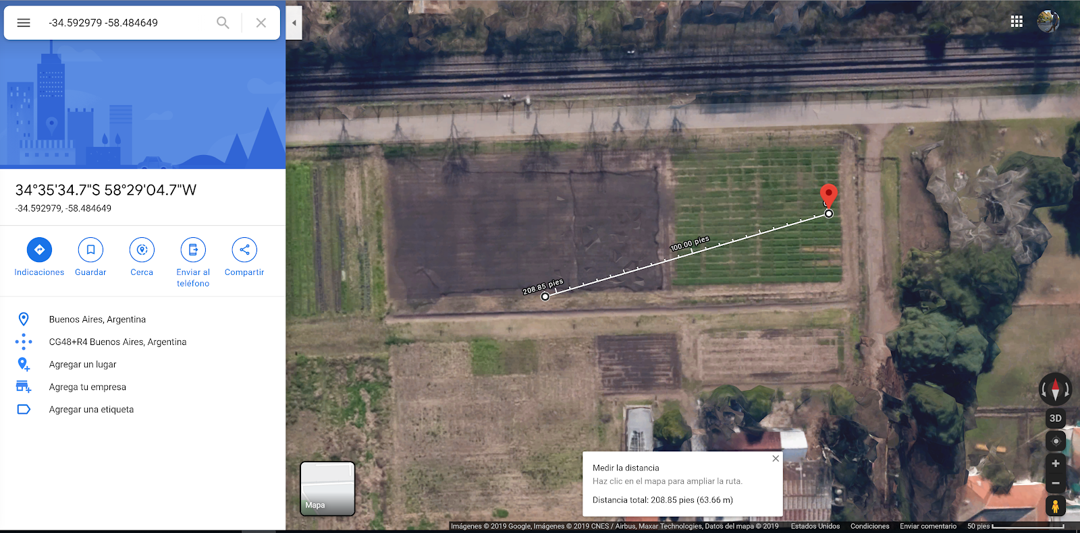
Geodetic/Ellipsoidal vs. Google Maps

Slide 19
Controlled Growth
Selected Coordinate from Yellow Square:
Longitude = [-58.484668]
Latitude = [-34.593059]

Slide 20
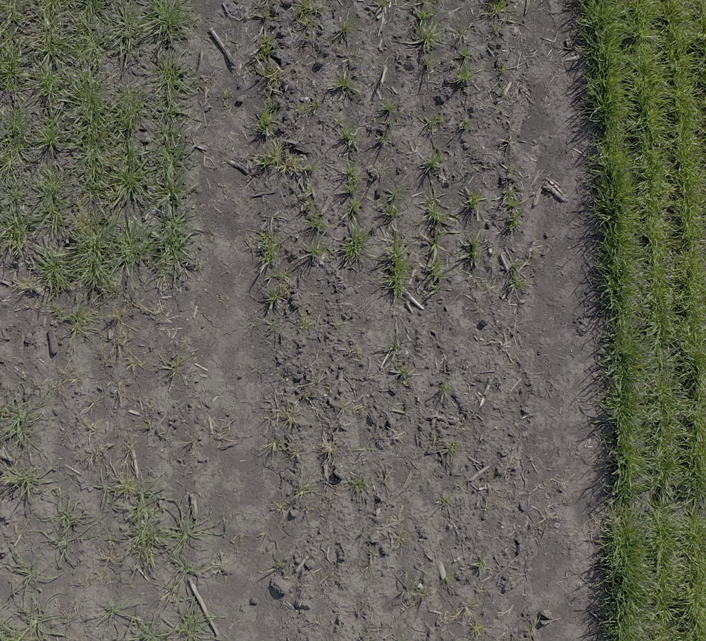
Selected Parcel Stage 1

Slide 21
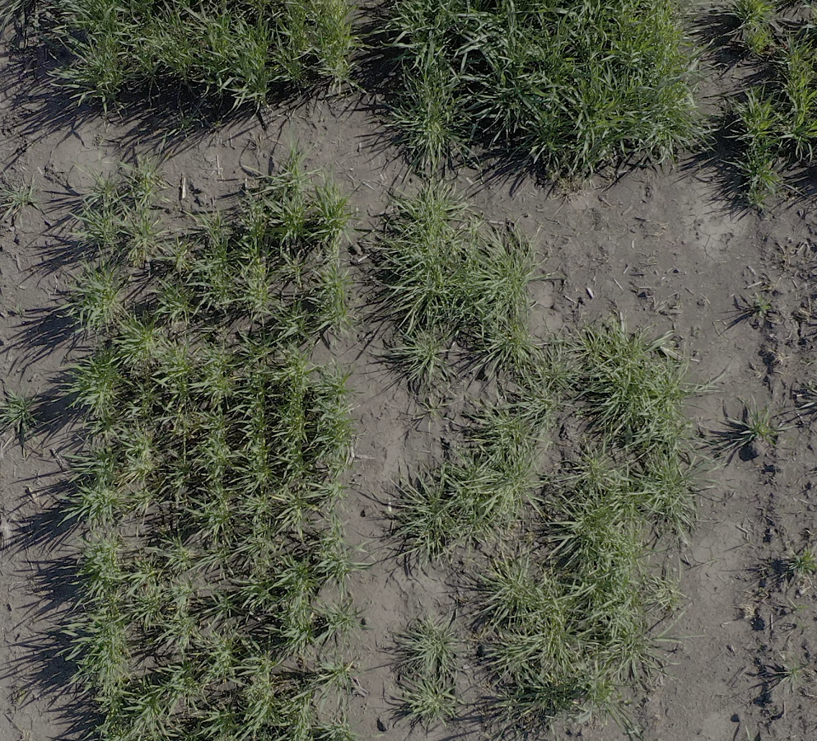
Selected Parcel Stage 2

Slide 22
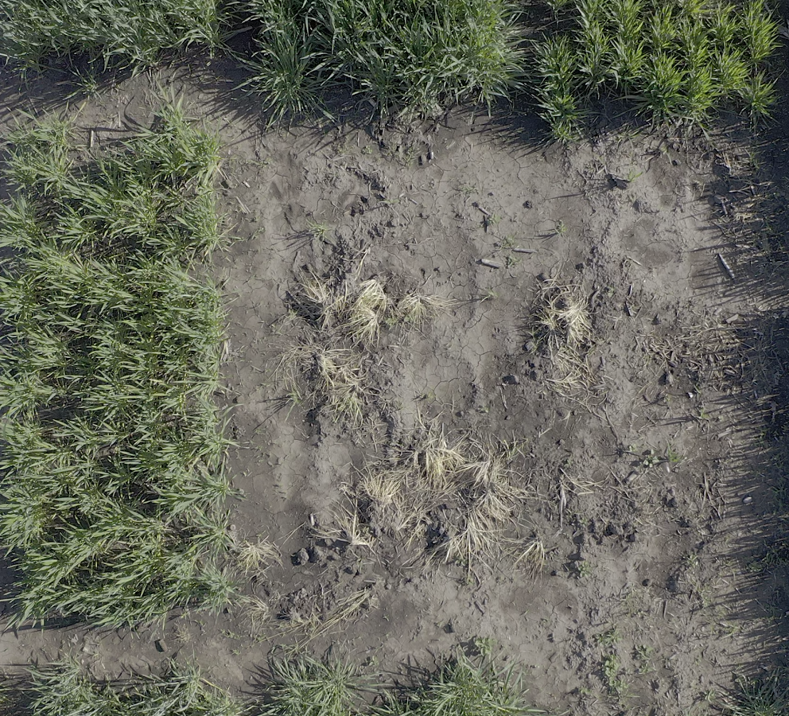
Selected Parcel Stage 2

Slide 23
Green Index
The classification of the excess green index is a simple mathematical operation with the RGB channels of an image and allows highlighting the green channel (G) of the rest of the red (R) and blue (B) channels.
(Eq.1) Igreen = 2.Igreen - Ired - Iblue

Slide 24
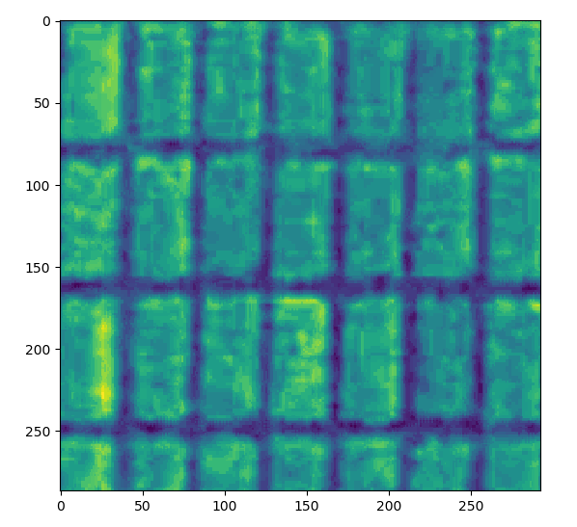
Green Index (Work Area)

Slide 25
Binary and Contours
Binary – For every pixel, the same threshold value is applied. If the pixel value is smaller than the threshold, it is set to 0; otherwise, it is set to a maximum value.
Contours can be explained simply as a curve joining all the continuous points (along the boundary), having same color or intensity.
The contours are a useful tool for shape analysis and object detection and recognition.

Slide 26
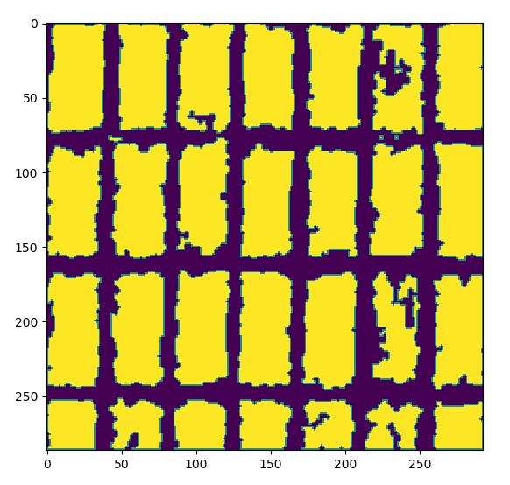
Find Binary Image and Contours

Slide 27
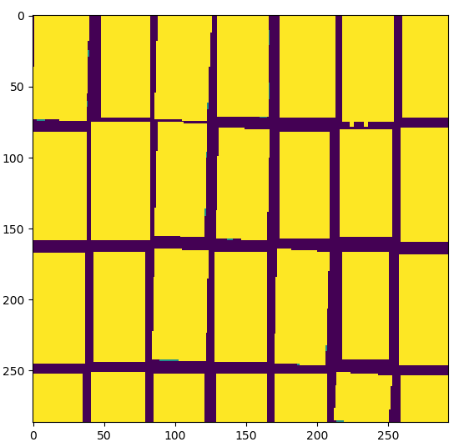
Find rectangles with minimum area and fill them.
Notes:
9 - 27 UNQ

Slide 28
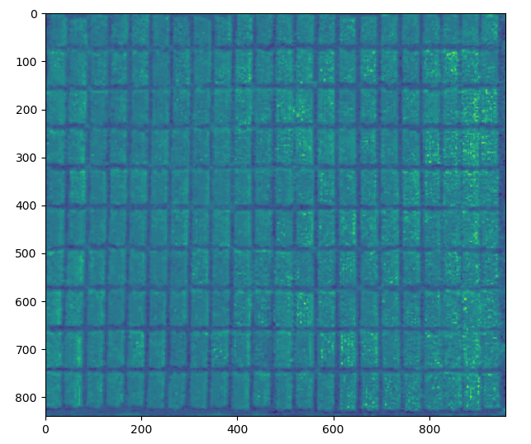
Green Index (Work Area)

Slide 29
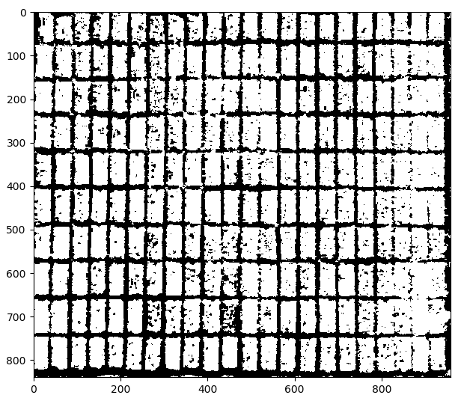
Binarization of Work Area

Slide 30
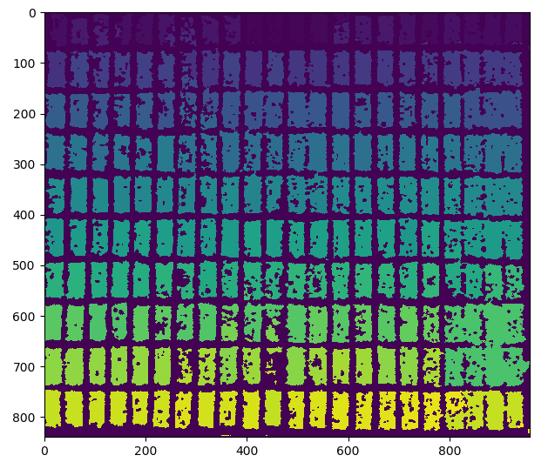
Contours Filled in Work Area

Slide 31
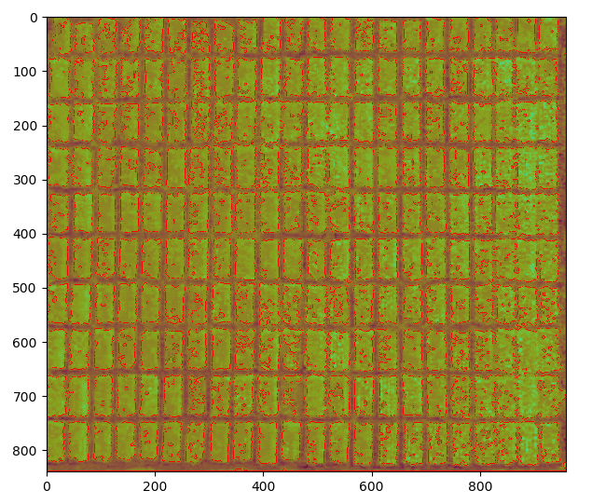
Original Form of Contours Found in Work Area

Slide 32
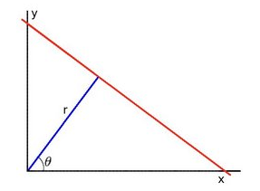
Classification by Hough Space
Hough transform is a feature extraction method for detecting simple shapes such as circles, lines.
For example, a line can be represented by two parameters (slope, intercept).

Slide 33
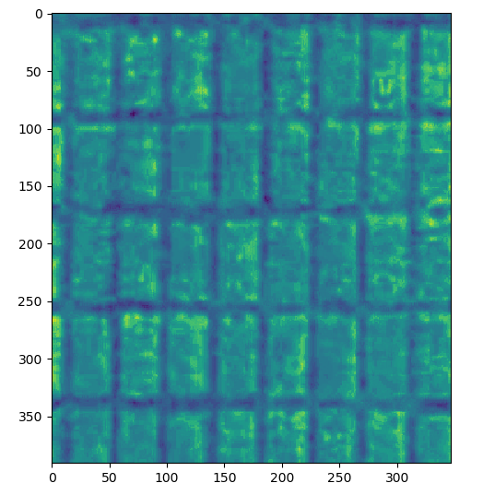
Select Work Area

Slide 34
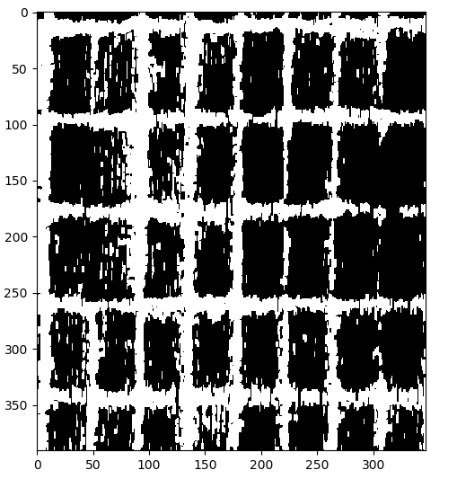
Binarization of Work Area

Slide 35
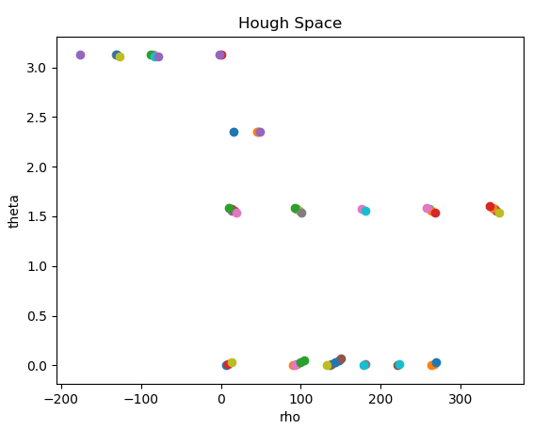
Classification by Hough Space (No Filter)

Slide 36
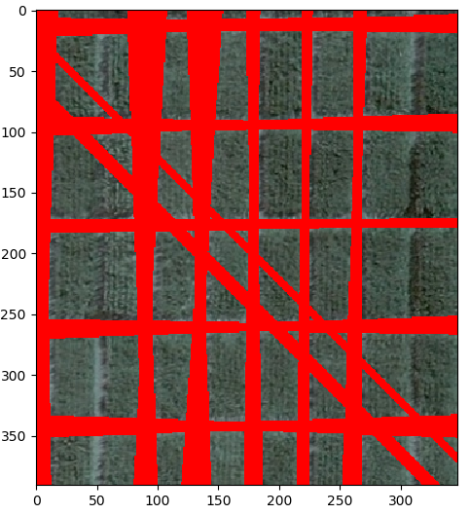
Draw Hough Space Lines to Detect Crop Fields (No Filter)

Slide 37
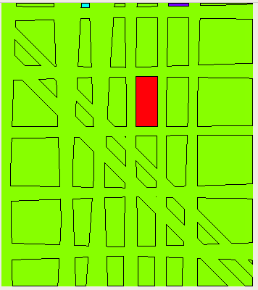
Labeled Crop Fields (No Filter)

Slide 38
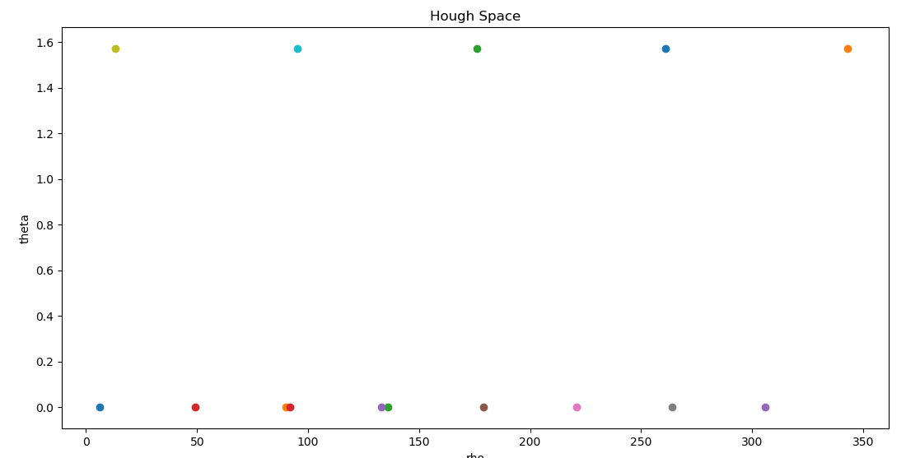
Classification by Hough Space (With Filters)

Slide 39
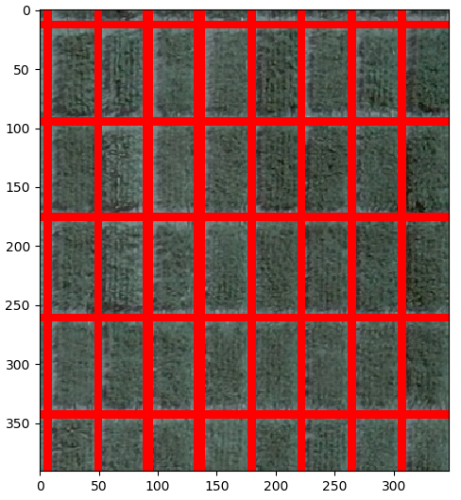
Draw Hough Space Lines to Detect Crop Fields (With Filters)

Slide 40
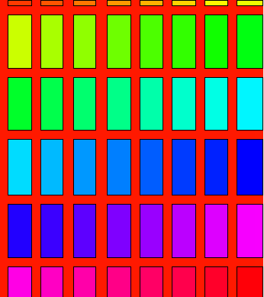
Labeled Crop Fields (With Filter)

Slide 41
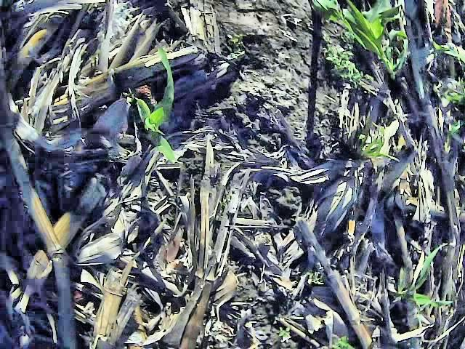
Weed Detection Video – Original

Slide 42
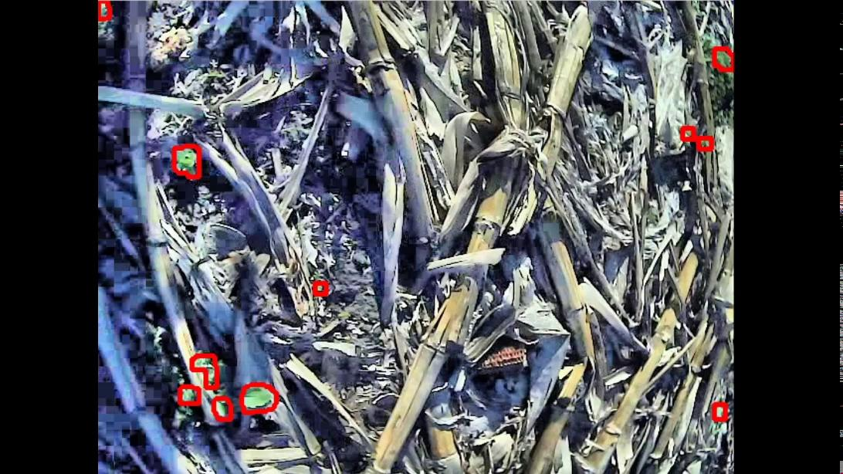
Weed Detection Video – Final Video

Slide 43
Conclusion
So far, the team has completed Task 1 (Detection of Crop Lines and Weeds) and Task 2 (Geolocation to locate points of interest.
Complete Task 3 (Visualization of Information with Open Geographic Information System (GIS) Tools).

